Slide 1
Week 2
Network Traffic Analysis,
Nmap and Windows Logging
Name: Kunal Jain
Organization: DG Interns Hub
Date: 30 Oct 2026

Slide 2
Week 2: purpose and objectives
• Understand how TCP connections are established, used and closed.
• Inspect DNS, HTTP/TLS, ARP, ICMP and SMB traffic.
• Use Wireshark filters to isolate relevant packets.
• Compare Nmap scan methods and their network footprints.
• Read Windows Security events and investigate authentication/account activity.
• Connect network evidence with endpoint logs for SOC analysis.
2

Slide 3
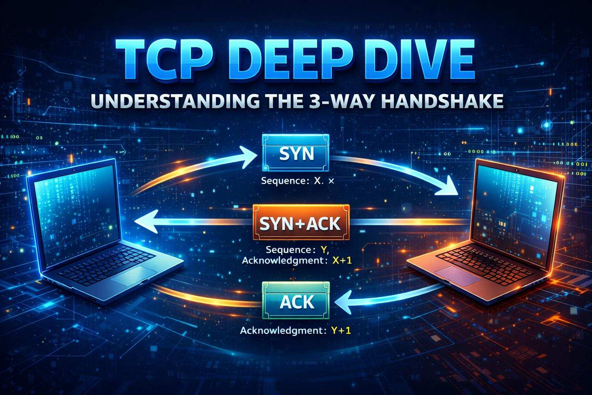
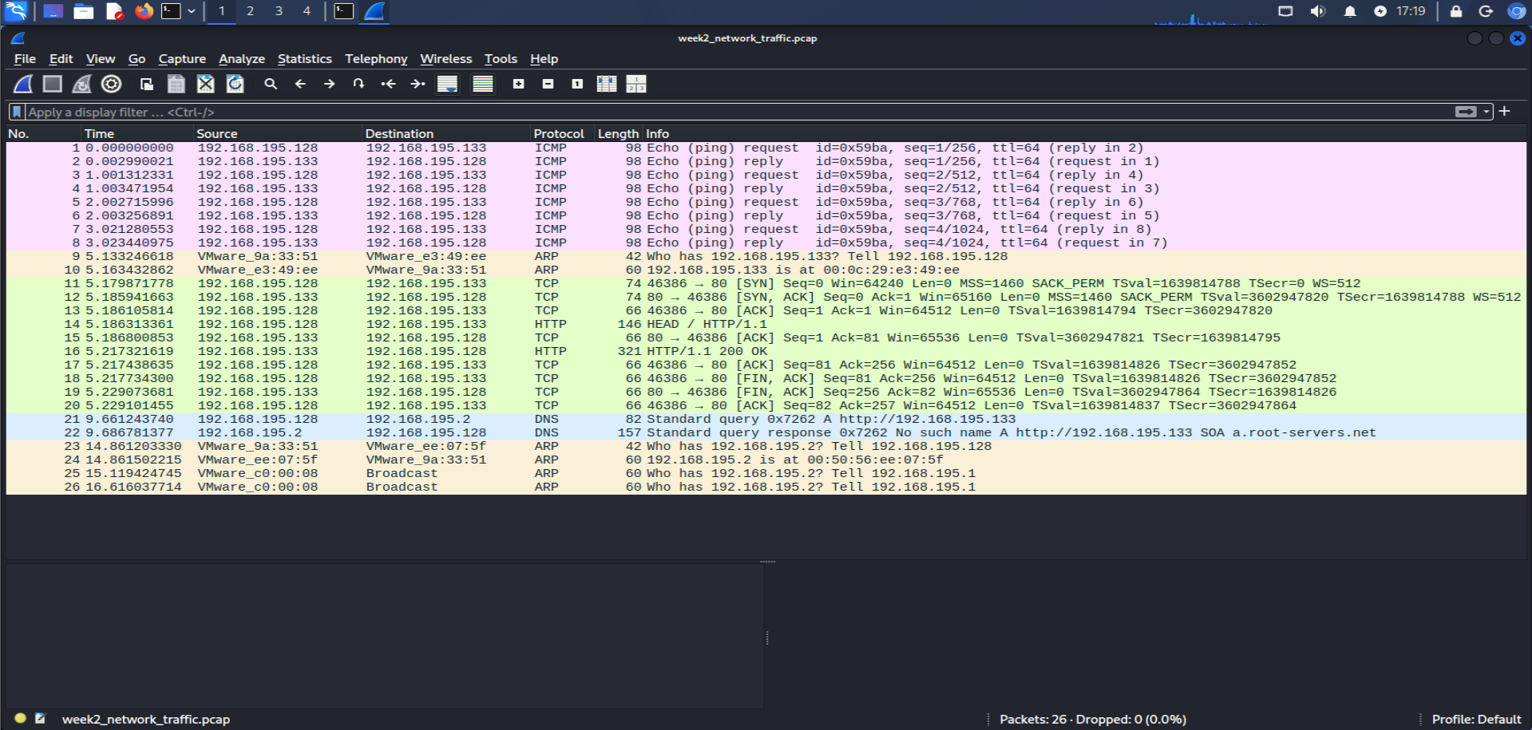
TCP handshake and teardown
• Handshake: SYN → SYN/ACK → ACK. The client requests a connection; the server acknowledges and offers its sequence number; the client confirms.
• Data exchange follows once the connection is established.
• Graceful teardown commonly uses FIN/ACK exchanges in both directions.
• RST abruptly resets a connection; it is not a normal graceful close.
• Flags: SYN (start), ACK (acknowledge), FIN (finish), RST (reset), PSH (push data), URG (urgent pointer).
3

Slide 4
What to inspect in common protocols
• DNS: query volume, unusual/random domains, repeated failures, unexpected resolvers.
• HTTP: methods, URI, user agent, cleartext credentials, unexpected uploads or destinations.
• HTTPS/TLS: handshake, certificate, SNI where visible, unusual destinations and repeated failures; payload is encrypted.
• ARP: IP-to-MAC mapping changes, unsolicited replies and possible spoofing.
• ICMP: echo request/reply patterns, sweeps, high volume or unusual payloads.
• SMB: unexpected shares, authentication failures, cross-segment access and lateral movement patterns.
4

Slide 5
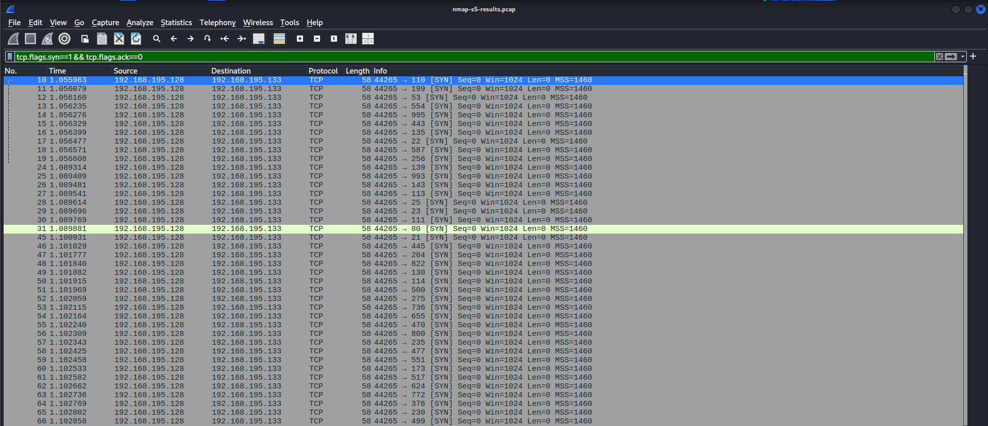
Wireshark: capture vs display filters
• Capture filters run before recording and reduce which packets enter the capture file.
• Display filters run after capture and only change which packets are shown.
• Display examples: dns | http.request | icmp | tcp.flags.syn == 1 && tcp.flags.ack == 0.
• Use capture filters to limit collection; use display filters to investigate a saved PCAP.
5

Slide 6
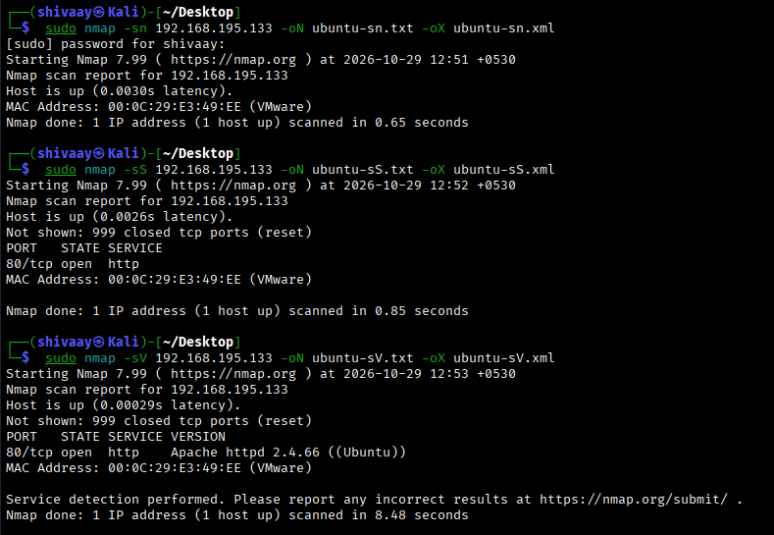
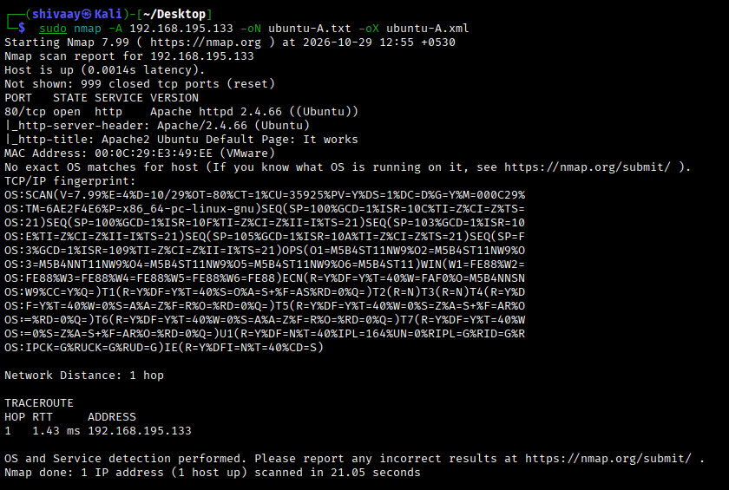
Nmap scan types and their footprint
• -sn: host discovery only; may use ARP, ICMP or TCP/UDP probes.
• -sS: SYN/half-open scan; SYNs go out, open ports often answer SYN/ACK, closed ports often answer RST.
• -sT: completes TCP connections using the OS connect() call.
• -sU: UDP probes; ICMP port-unreachable can indicate a closed UDP port.
• -sV: probes services to identify product/version; -O fingerprints the OS.
• -A: combines OS detection, version detection, default scripts and traceroute; more visible activity.
6

Slide 7
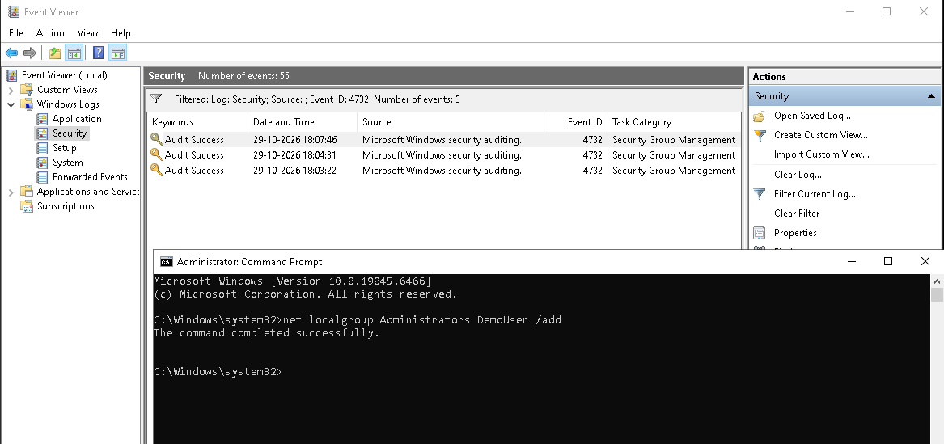
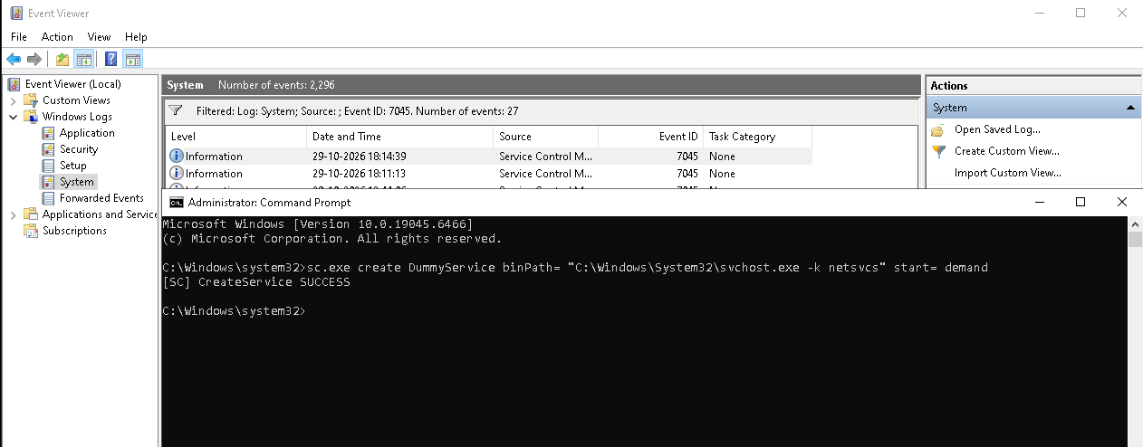
Windows foundations and Event Viewer
• Processes: running program instances with a PID and security context.
• Services: background components managed by the Service Control Manager.
• Registry: hierarchical store for Windows and application configuration.
• Users/groups: identities and permission collections; Administrators is highly privileged.
• UAC: helps prevent unintended elevation of privileges.
• Event Viewer: Application (software), Security (audit), System (OS/services/drivers).
7

Slide 8
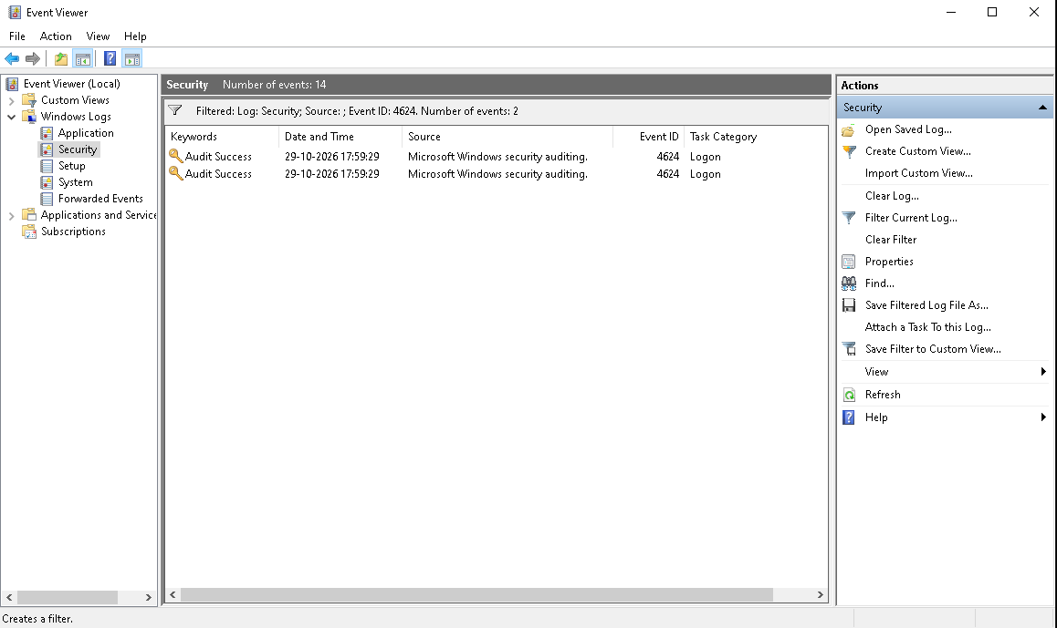
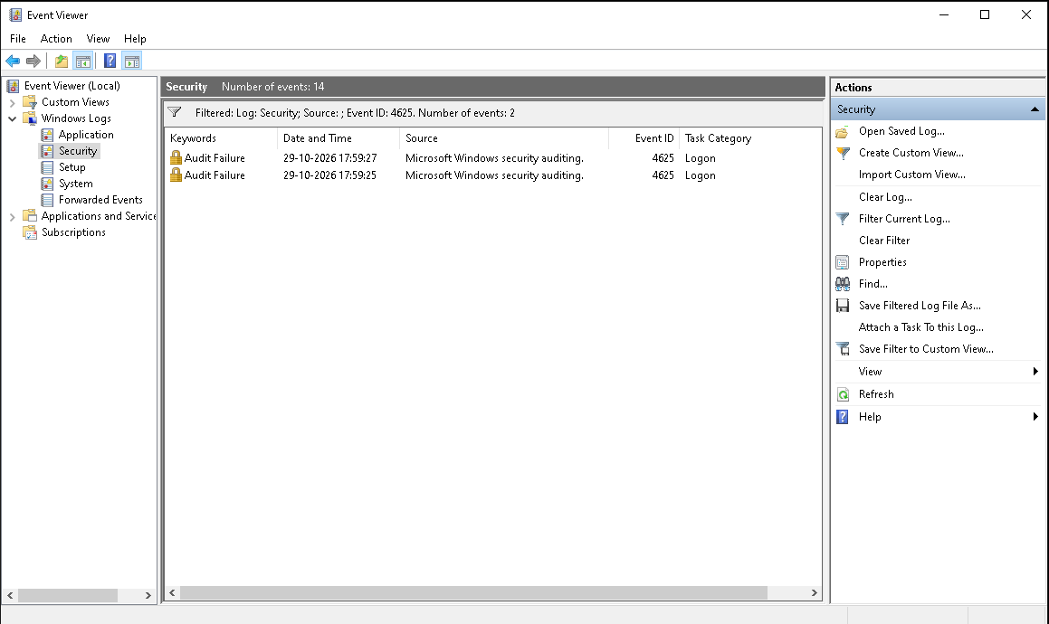
Windows Security Event IDs: quick map
• 4624 successful logon | 4625 failed logon | 4634 logoff | 4648 explicit credentials.
• 4672 special privileges | 4688 process created | 4697 service installed.
• 4720 account created | 4722 account enabled | 4724 password reset attempt.
• 4732 member added to local security group.
• 4768 Kerberos TGT requested | 4769 Kerberos service ticket requested.
• 4776 NTLM credential validation | 1102 audit log cleared.
8

Slide 9
Practical workflow and evidence
• Traffic: capture TCP handshake, HTTP GET, DNS query and ICMP echo; save PCAP.
• Nmap: run -sn, -sS, -sV, -O and -A against authorised Ubuntu and Windows VMs; save -oN and -oX.
• Wireshark: inspect SYN scan using tcp.flags.syn==1 && tcp.flags.ack==0.
• Windows: collect 4625, 4624 with logon type, 4720, 4732, service install (7045) and 1102 in a controlled lab.
• PowerShell: export 4625 events to CSV and group failure counts by account.
• TryHackMe and sample PCAPs: save separate writeups with observations.
10

Slide 10
WEEK 2
Baseline: why normal matters
• A baseline describes expected behaviour for a host, user, service, network segment or time period.
• It includes normal destinations, ports, login times, service activity, traffic volume and process behaviour.
• Without a baseline, legitimate administration can look suspicious and real anomalies can be missed.
• Compare activity with role, asset criticality, time, source, frequency and historical patterns.
• Escalate anomalies using multiple signals and supporting evidence—not one event in isolation.
DG Interns Hub | Network Traffic Analysis, Nmap and Windows Logging
12

